Slide 1
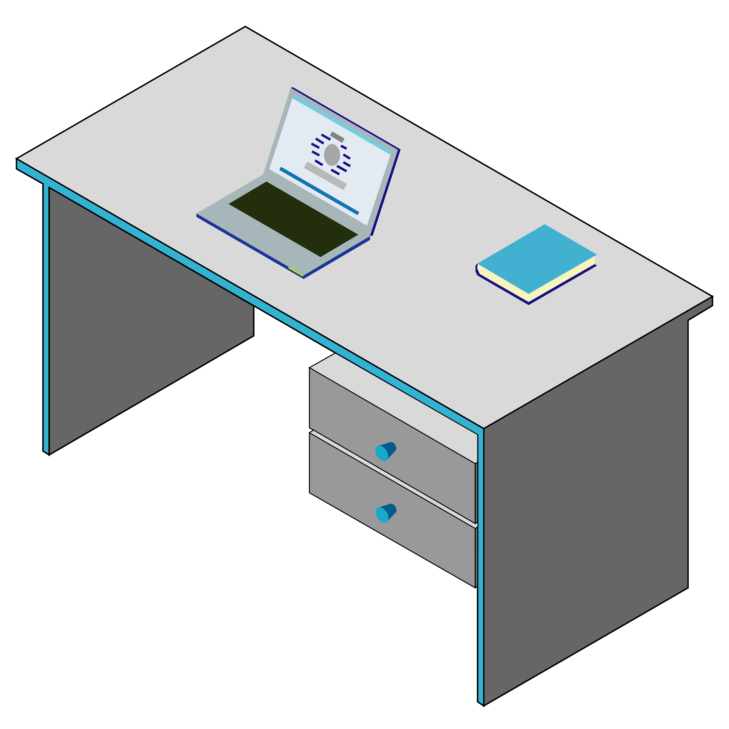
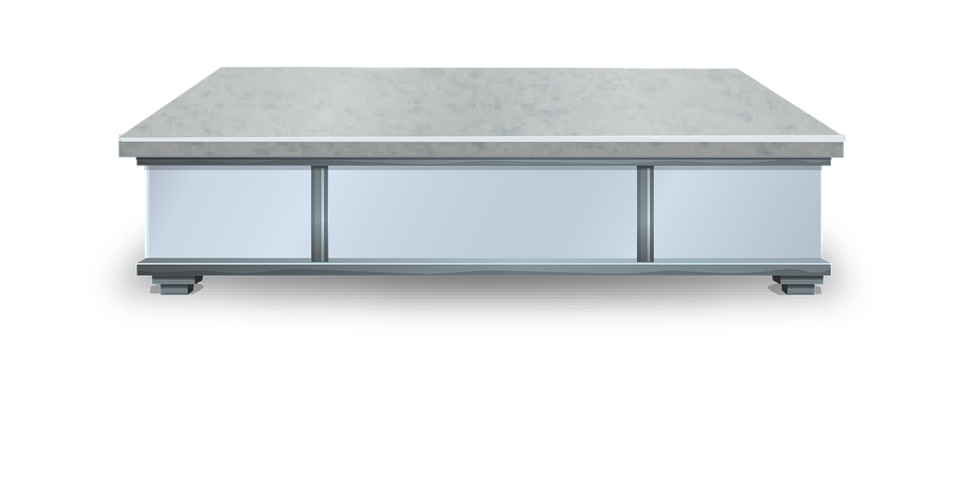
How to set up a learning space at home

Slide 2
Get ready for Learning!!
Get dressed appropriately for video
Make sure you’re looking fine!
Have a good breakfast
Brush your teeth

Slide 3
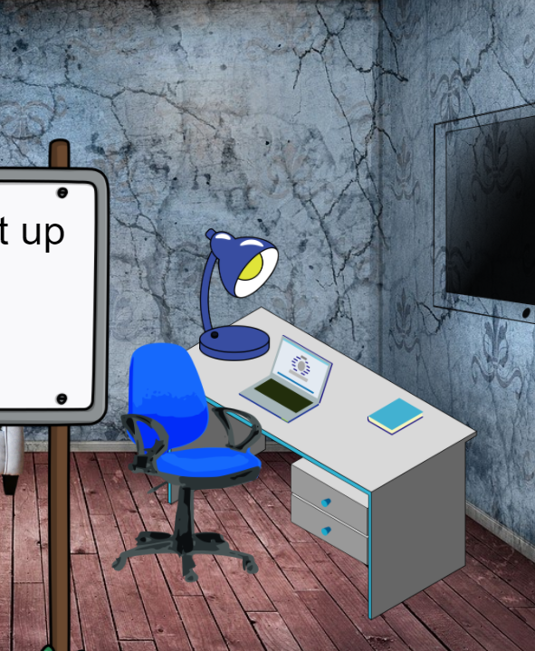
Set up a space that won’t be in the way of others

Slide 4
Be sure to have your device ready and charged!

Slide 5
Have supplies handy…...

Slide 6
Make sure you have good lighting to see!

Slide 7
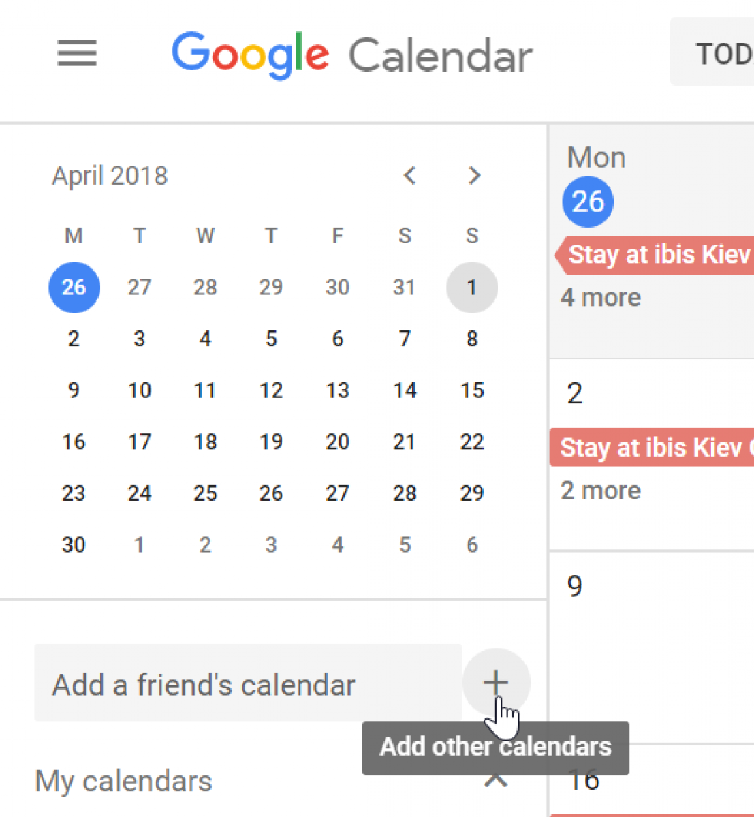
Use a Calendar to keep track of class & assignments

Slide 8
Plan your time. Set alarms for class.

Slide 9
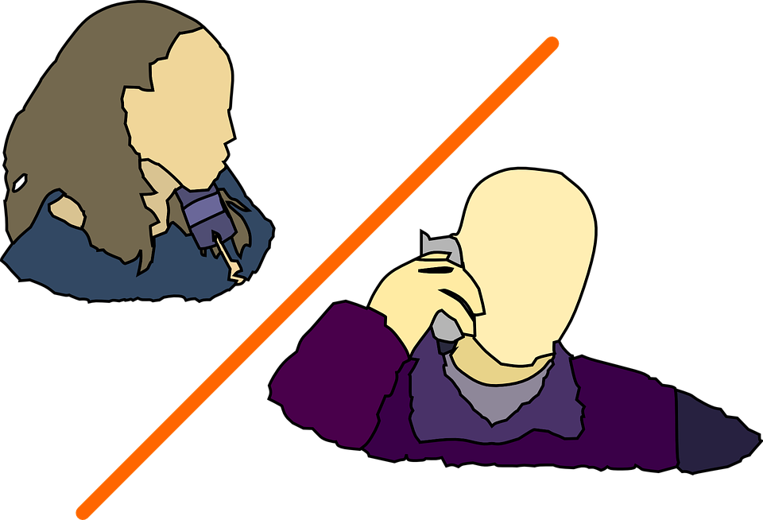
Help Deal with Emotions and Communication
Email a friend or a teacher and check on them
Zoom a friend to keep in touch with
Phone a friend

Slide 10
There’s always HELP!
Ask a Teacher for Help
Tech Support from School
Online Tech Support from Companies

Slide 11
Check on your friends and support each other!

